Slide 1
Image captioning
Industrial training report
Submitted in partial fulfilment of the requirement for the degree of
Bachelor of Technology
In
Information Technology
By
KESHAV – 40796303117

Slide 2
CANDIDATE’S DECLARATION
I, KESHAV , Roll No. 40796303117, B.Tech (Semester- 5th ) of the Maharaja Surajmal Institute of Technology, New Delhi hereby declare that the Training Report entitled “IMAGE CAPTIONING” is an original work and data provided in the study is authentic to the best of my knowledge. This report has not been submitted to any other Institute for the award of any other degree.

Slide 3
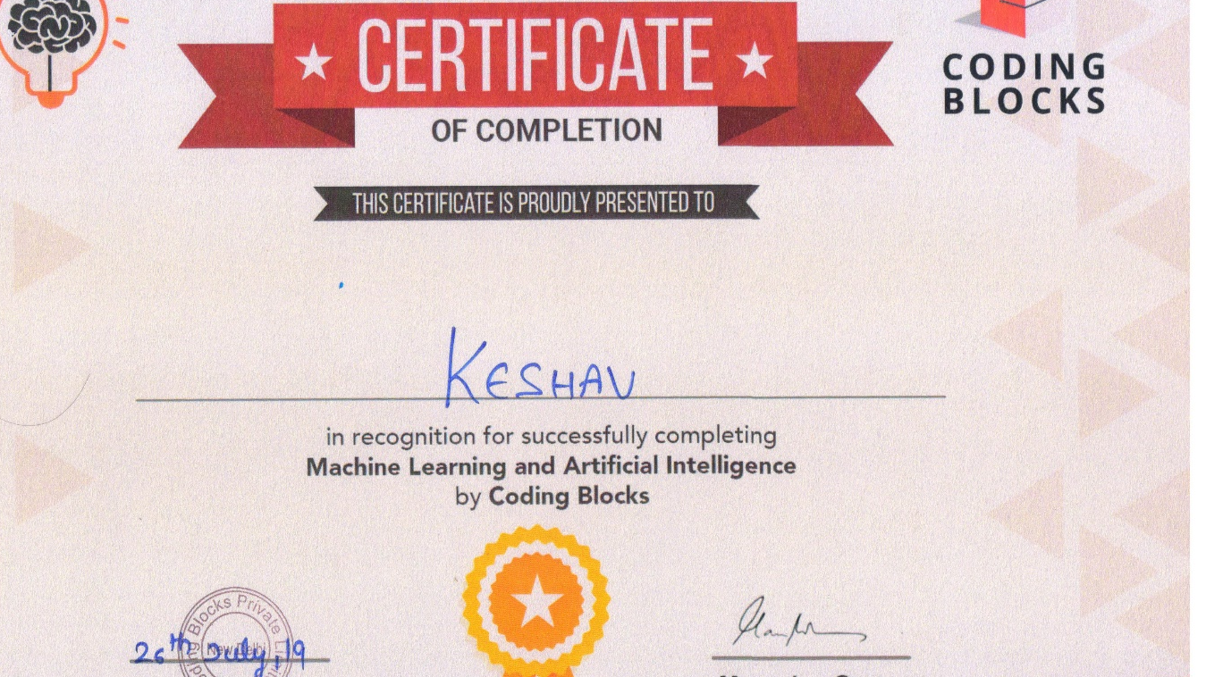
CERTIFICATE

Slide 4
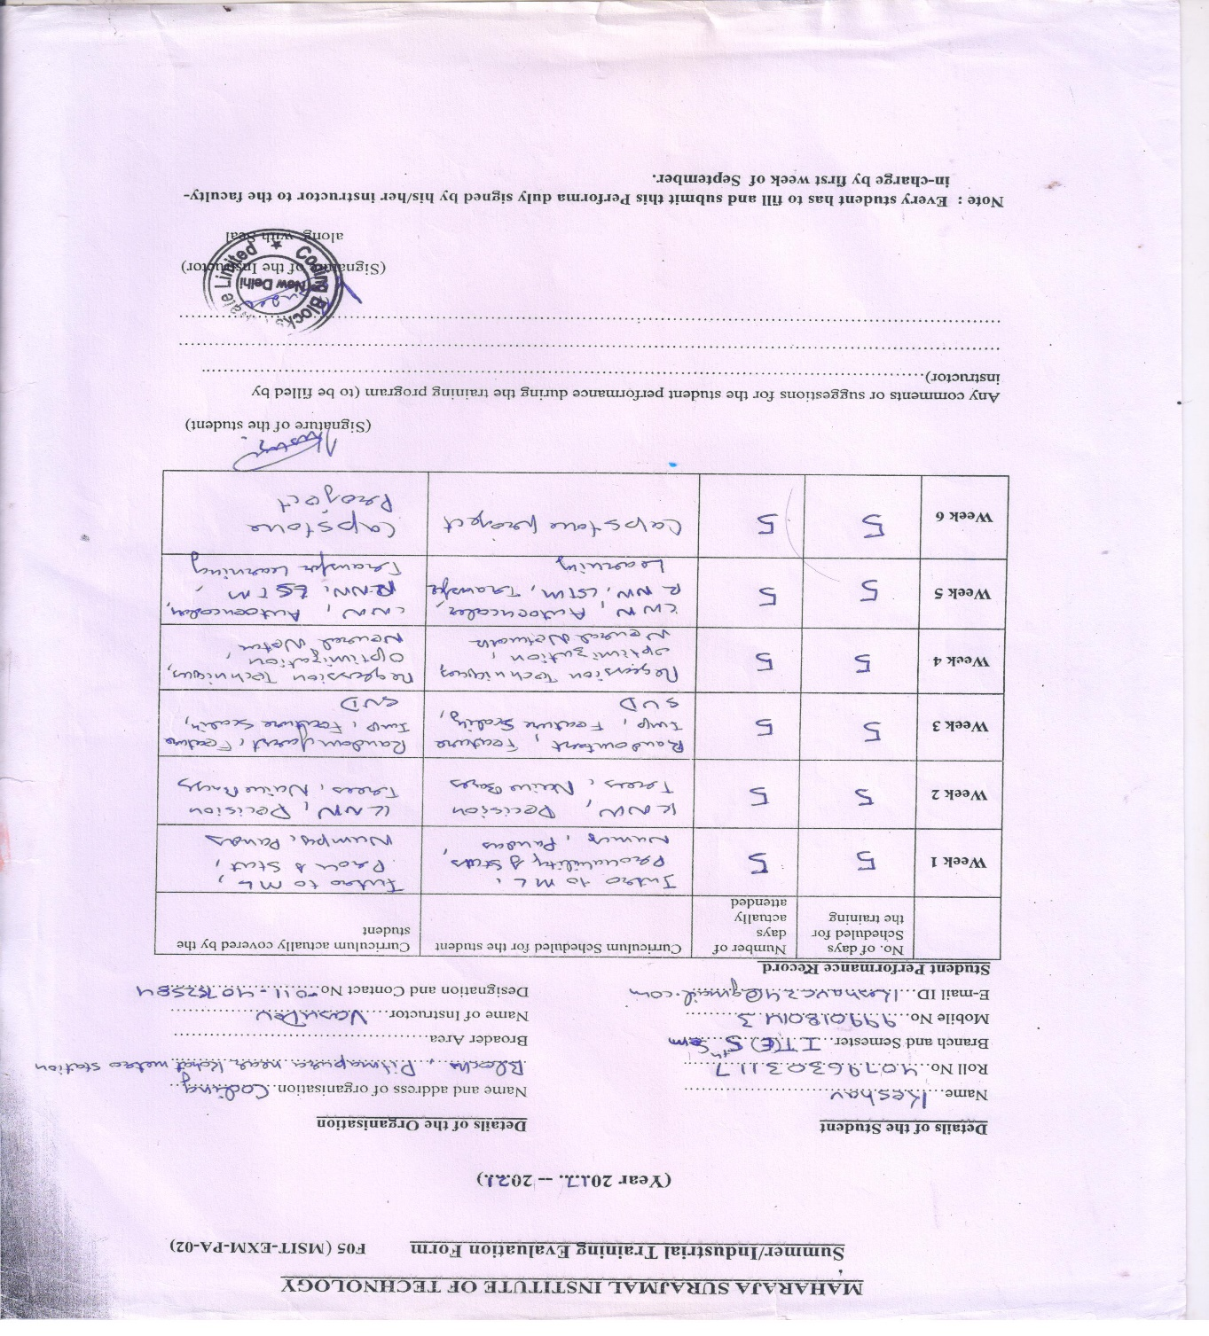
EVALUATION FORM

Slide 5
ACKNOWLEDGEMENT
The success and outcome of this project required a lot of guidance and assistance from many people and I am extremely privileged to have got this all along the completion of my project. All that I have done is only due to such supervision and assistance and I would not forget to thank them.
I respect and thank Mr. Vasu Dev, for providing me an opportunity to do the project work in Coding Blocks and giving us all support and guidance which made me complete the project duly. I owe my deep gratitude towards him, who took keen interest on our project work and guided us all along, till the completion of our project work by providing all the necessary information for developing a good system.
I express my gratitude to Mr. Manoj Malik (HOD, IT) for motivating and allowing
me to complete the summer training in good schedule.
Also I would like to thank Mrs. Tripti Rathi (Proctor, Information Technology Engineering Evening) for her immense help regarding the project.
I would also thank all the Information Technology Department faculty members of Maharaja Surajmal Institute of Technology, C-4 Janakpuri for their critical advice and guidance without which this summer training would not have been possible.
Last but not least I place a deep sense of gratitude to my family members and my friends who have been constant source of inspiration during the training period.

Slide 6
ABSTRACT
Caption generation is a challenging artificial intelligence problem where a textual description must be generated for a given photograph.
It requires both methods from computer vision to understand the content of the image and a language model from the field of natural language processing to turn the understanding of the image into words in the right order. Recently, deep learning methods have achieved state-of-the-art results on examples of this problem.
Deep learning methods have demonstrated state-of-the-art results on caption generation problems. What is most impressive about these methods is a single end-to-end model can be defined to predict a caption, given a photo, instead of requiring sophisticated data preparation or a pipeline of specifically designed models.

Slide 7

Company Profile
Coding Blocks was founded in 2014 with a mission to create skilled Software Engineers for our country and the world. We are here to bridge the gap between the quality of skills demanded by industry and the quality of skills imparted by conventional institutes. At Coding Blocks, we strive to increase student interest by providing hands on practical training on every concept taught in the classroom.
We at Coding Blocks strongly believe that with the right guidance and perfect determination, any student willing to learn programming can become a master of coding. All team members at Coding Blocks are aces of their respective field and the share the highest level of commitment towards quality teaching and student success and satisfaction. The present structure of computer education in colleges and universities is not aligned to the needs of the IT Industry. Students have no place to go and bridge this huge gap. It was this realization that prompted me to address this very real need of the student community. Coding Blocks was started as a learning centre where we teach fundamentals of programming to college students. The courses here are designed to help students with their curriculum and give them a real feel of the IT industry. In the last three years, we have helped more than 7200 students achieve their goal and made them the darling of the industry.

Slide 8
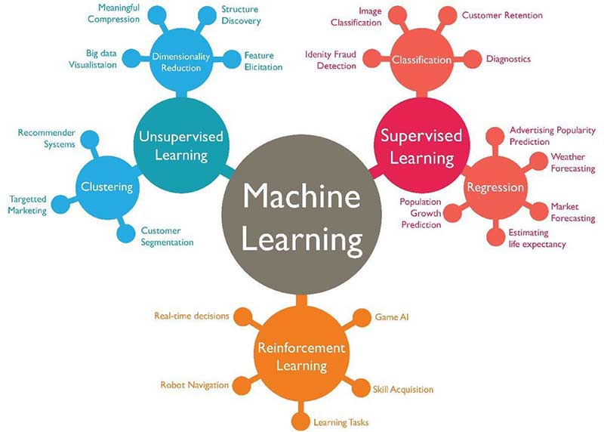
Machine Learning
Machine learning is a subfield of artificial intelligence (AI). The goal of machine learning generally is to understand the structure of data and fit that data into models that can be understood and utilized by people.
Although machine learning is a field within computer science, it differs from traditional computational approaches. In traditional computing, algorithms are sets of explicitly programmed instructions used by computers to calculate or problem solve. Machine learning algorithms instead allow for computers to train on data inputs and use statistical analysis in order to output values that fall within a specific range. Because of this, machine learning facilitates computers in building models from sample data in order to automate decision-making processes based on data inputs.

Slide 9


ANACONDA
Anaconda is the world‘s most popular Python data science platform. Anaconda, Inc. continues to lead open source projects like Anaconda, NumPy and SciPy that form the foundation of modern data science. Anaconda‘s flagship product, Anaconda Enterprise, allows organizations to secure, govern, scale and extend Anaconda to deliver actionable insights that drive businesses and industries forward.

Slide 10

Keras
Keras is a high-level neural networks API, written in Python and capable of running on top of TensorFlow, CNTK, or Theano. It was developed with a focus on enabling fast experimentation. Being able to go from idea to result with the least possible delay is key to doing good research.
Use Keras if you need a deep learning library that:
Allows for easy and fast prototyping (through user friendliness, modularity, and extensibility).
Supports both convolutional networks and recurrent networks, as well as combinations of the two.
Runs seamlessly on CPU and GPU.
Read the documentation at Keras.io.
Keras is compatible with: Python 2.7-3.6.

Slide 11
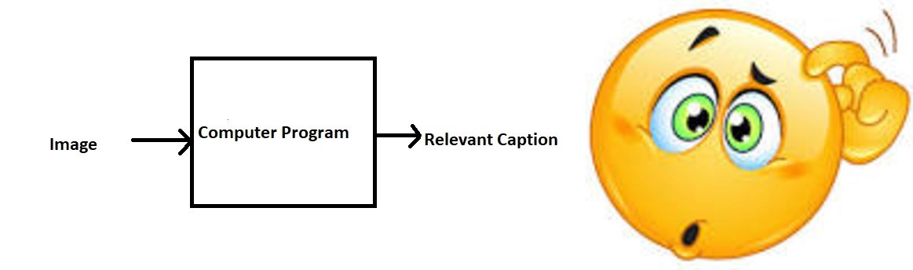
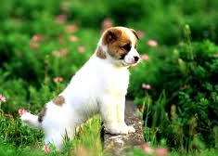
Overview of the project
Can you write a caption?
Well some of you might say “A white dog in a grassy area”, some may say “White dog with brown spots” and yet some others might say “A dog on grass and some pink flowers”
Definitely all of these captions are relevant for this image and there may be some others also.
But the point I want to make is; it’s so easy for us, as human beings, to just have a glance at a
picture and describe it in an appropriate language. Even a 5 year old could do this with ease.
But, can you write a computer program that takes an image as input and produces a relevant caption as output?

Slide 12
Problem Statement
We must first understand how important this problem is to real world scenarios. Let’s see few applications where a solution to this problem can be very useful.
Self driving cars — Automatic driving is one of the biggest challenges and if we can properly caption the scene around the car, it can give a boost to the self driving system.
Aid to the blind — We can create a product for the blind which will guide them travelling on the roads without the support of anyone else. We can do this by first converting the scene into text and then the text to voice. Both are now famous applications of Deep Learning. Refer this where its shown how Nvidia research is trying to create such a product.
CCTV cameras are everywhere today, but along with viewing the world, if we can also generate relevant captions, then we can raise alarms as soon as there is some malicious activity going on somewhere. This could probably help reduce some crime and/or accidents.
Automatic Captioning can help, make Google Image Search as good as Google Search, as then every image could be first converted into a caption and then search can be performed based on the caption.

Slide 13
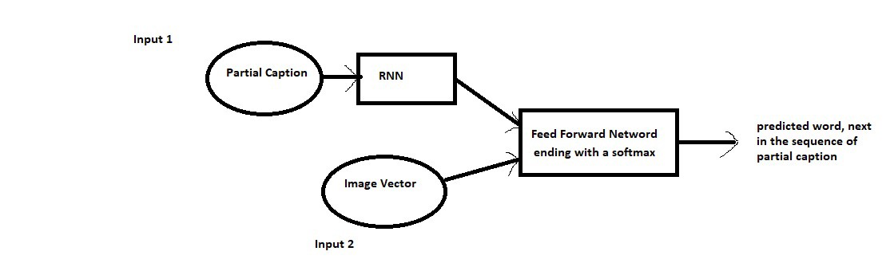
Model Architecture
Since the input consists of two parts, an image vector and a partial caption, we cannot use the Sequential API provided by the Keras library. For this reason, we use the Functional API which allows us to create Merge Models.
First, let’s look at the brief architecture which contains the high level sub-modules:

Slide 14
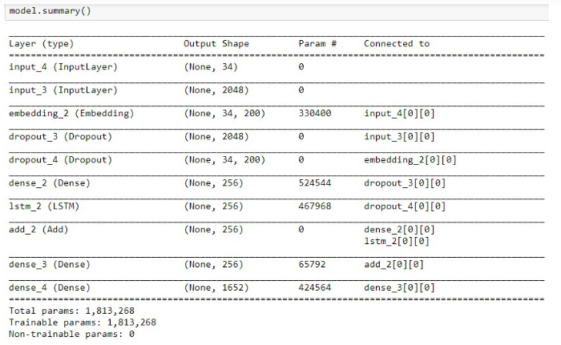
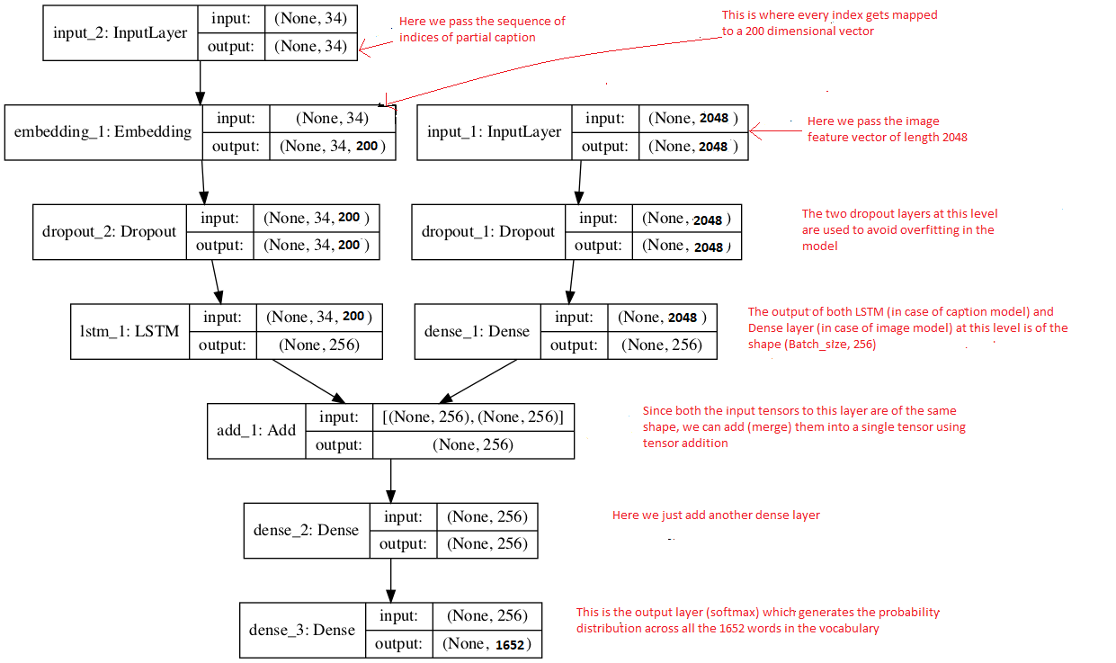

Slide 15
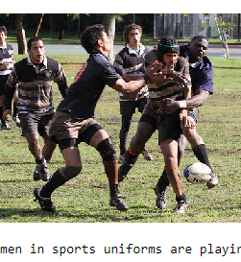
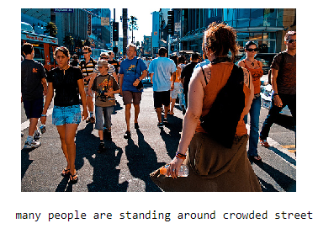
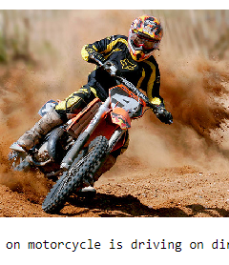
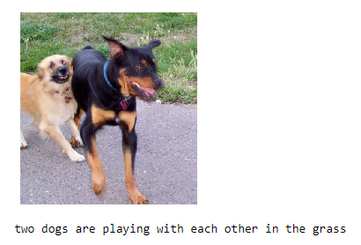
Results

Slide 16
BIBLIOGRAPHY
https://www.analyticsvidhya.com/blog/2018/04/solving-an-image-captioning-task-using-deep-learning/
https://www.appliedaicourse.com
https://www.kaggle.com/ming666/flicker8k-dataset
https://stackoverflow.com/
https://towardsdatascience.com/image-captioning-with-keras-teaching-computers-to-describe-pictures-c88a46a311b8
https://online.codingblocks.com/app/courses

Slide 17

Thank You

